Slide 1
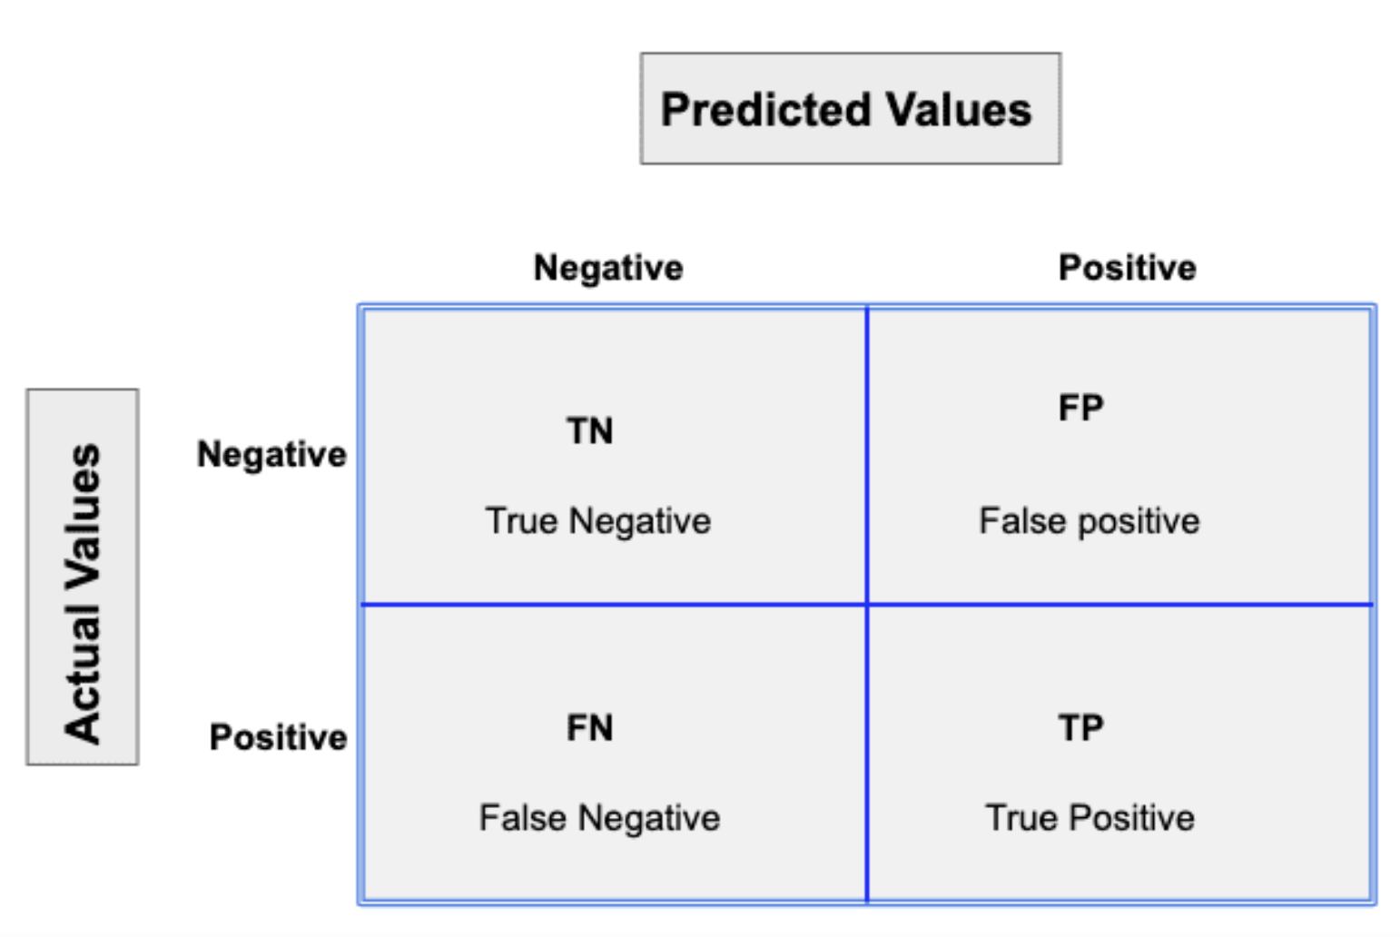

Metrics
Accuracy=$\frac{TP+TN}{TP+TN+FP+FN}$
Precision=$\frac{TP}{TP+FP}$
Recall=$\frac{TP}{TP+FN}$
F1-Score=$2∗\frac{Precision∗Recall}{Precision+Recall}$
AUC: Area under the receiver operating characteristic (ROC) curve.

Slide 2
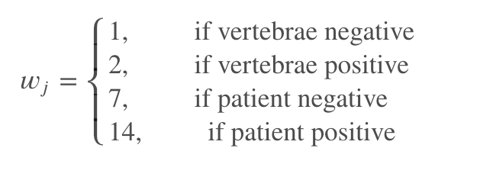
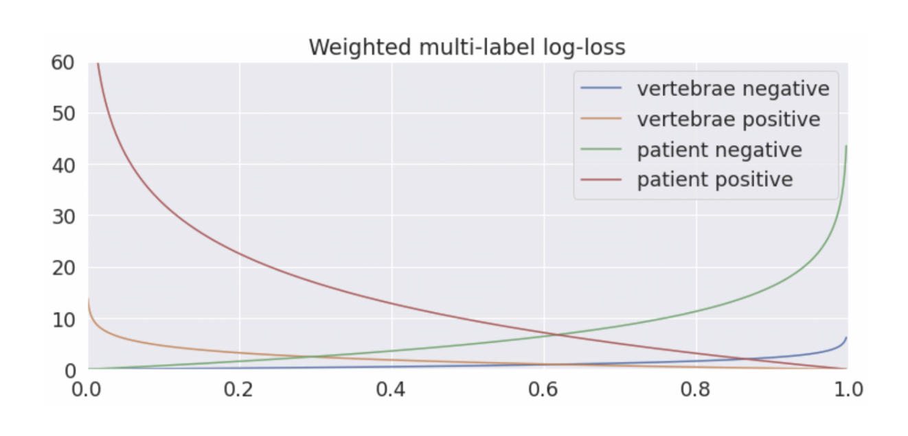
Loss Function
The competition metric is a weighted multi-label logarithmic loss

